Slide 1


INDIAN PREMIER LEAGUE AUCTION

Slide 2
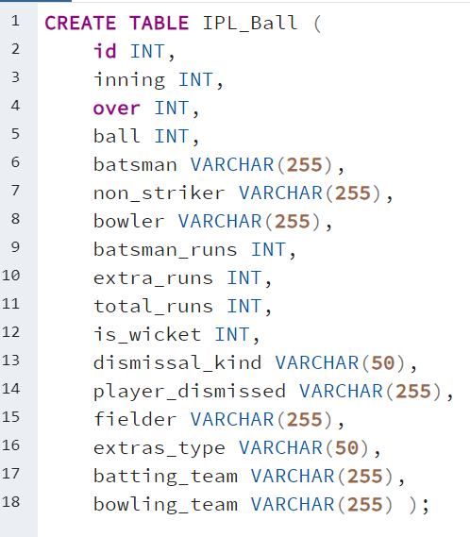
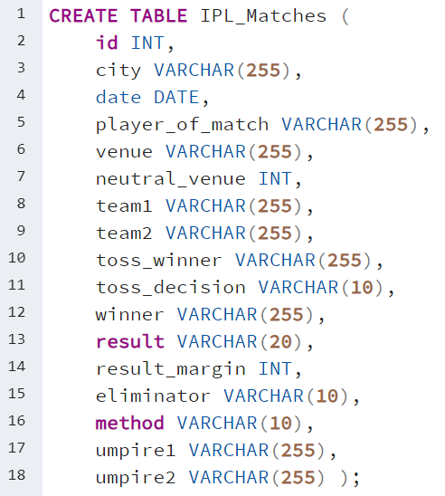
CREATING TABLES

Slide 3
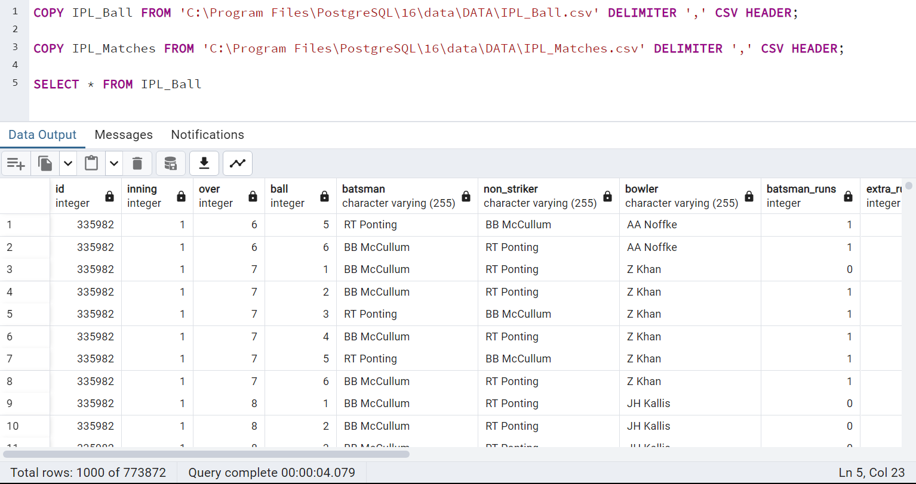
IMPORTING DATA INTO TABLES

Slide 4
PLAYERS WITH HIGHER
BATTING STRIKE RATE
SELECT batsman,
SUM(batsman_runs) AS total_runs,
COUNT(CASE WHEN extras_type != 'wides' THEN ball END) AS total_balls,
ROUND((SUM(batsman_runs) * 100.0 / COUNT(CASE WHEN extras_type != 'wides' THEN ball END)), 2) AS batsman_strike
FROM IPL_Ball
GROUP BY batsman
HAVING COUNT(CASE WHEN extras_type != 'wides' THEN ball END) >= 500
ORDER BY batsman_strike DESC
LIMIT 10;

Slide 5
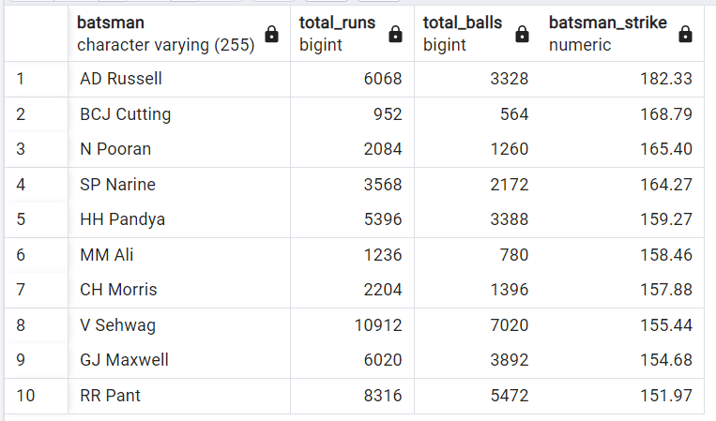

Slide 6
PLAYERS WITH GOOD
BATTING AVERAGE
SELECT batsman,
COUNT(DISTINCT EXTRACT(YEAR FROM ipl_matches.date)) AS seasons_played,
SUM(batsman_runs) AS total_runs,
SUM(is_wicket) AS times_dismissed,
SUM(batsman_runs) / NULLIF(SUM(is_wicket), 0) AS batting_average
FROM IPL_Ball
JOIN IPL_Matches ON IPL_Ball.id = IPL_Matches.id
GROUP BY batsman
HAVING COUNT(DISTINCT EXTRACT(YEAR FROM ipl_matches.date)) > 2 AND SUM(is_wicket) > 0
ORDER BY batting_average DESC
LIMIT 10;

Slide 7
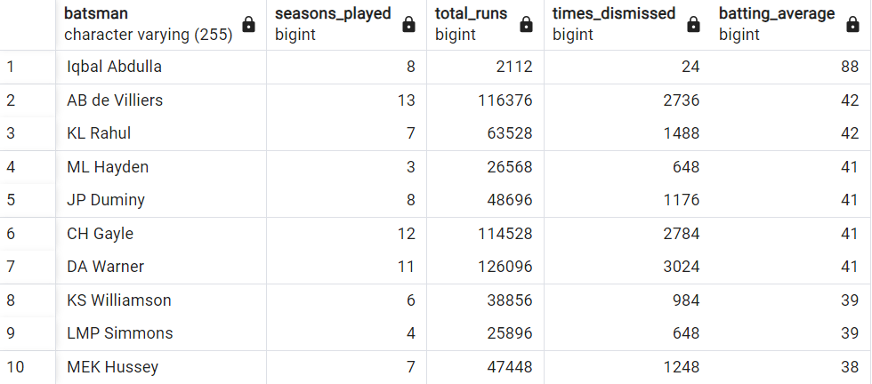

Slide 8
HARD - HITTING PLAYERS
SELECT batsman,
COUNT(DISTINCT EXTRACT(YEAR FROM ipl_matches.date)) AS seasons_played,
SUM(CASE WHEN batsman_runs = 4 THEN 1 ELSE 0 END) AS fours,
SUM(CASE WHEN batsman_runs = 6 THEN 1 ELSE 0 END) AS sixes,
SUM(batsman_runs) AS total_runs,
(SUM(CASE WHEN batsman_runs = 4 THEN 1 ELSE 0 END) * 4 + SUM(CASE WHEN batsman_runs = 6 THEN 1 ELSE 0 END) * 6) AS boundary_runs,
CONCAT(ROUND(((SUM(CASE WHEN batsman_runs = 4 THEN 1 ELSE 0 END) * 4 + SUM(CASE WHEN batsman_runs = 6 THEN 1 ELSE 0 END) * 6) * 100.0) / NULLIF(SUM(batsman_runs), 0), 0), '%') AS boundary_percentage
FROM IPL_Ball
JOIN IPL_Matches ON IPL_Ball.id = IPL_Matches.id
GROUP BY batsman
HAVING COUNT(DISTINCT EXTRACT(YEAR FROM ipl_matches.date)) > 2
ORDER BY boundary_percentage DESC
LIMIT 10;

Slide 9
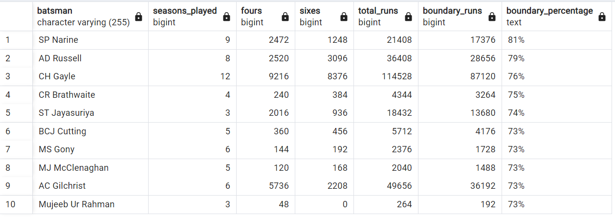

Slide 10
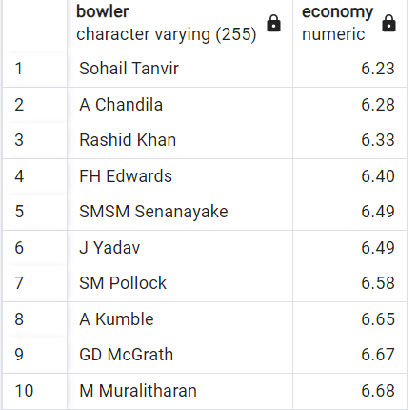
ECONOMICAL BOWLERS
SELECT bowler,
ROUND((SUM(total_runs) / (count(bowler)/6.0)),2) AS Economy
FROM ipl_ball
GROUP BY bowler
HAVING COUNT(bowler) >= 500
ORDER BY Economy
LIMIT 10;

Slide 12
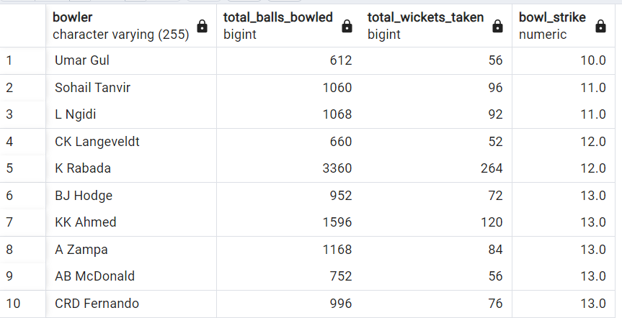
BOWLERS WITH HIGHER STRIKE RATE
SELECT bowler,
COUNT(ball) AS total_balls_bowled,
SUM(is_wicket) AS total_wickets_taken,
ROUND(COUNT(ball) / NULLIF(SUM(is_wicket), 0), 1) AS bowl_strike
FROM IPL_Ball
GROUP BY bowler
HAVING COUNT(ball) >= 500
ORDER BY bowl_strike ASC
LIMIT 10;

Slide 14
ALL-ROUNDERS
SELECT
batsman AS all_rounder,
ROUND((SUM(batsman_runs) * 1.0 / NULLIF(COUNT(ball), 0) * 100), 2) AS bats_strike_rate,
b.bowl_strike_rate
FROM ipl_ball AS a
INNER JOIN (
SELECT
bowler,
COUNT(bowler) AS balls,
SUM(is_wicket) AS total_wicket,
ROUND((COUNT(bowler) * 1.0 / NULLIF(SUM(is_wicket), 0)), 2) AS bowl_strike_rate
FROM ipl_ball
GROUP BY bowler
HAVING COUNT(bowler) > 300
ORDER BY bowl_strike_rate ASC
) AS b ON a.batsman = b.bowler
WHERE NOT extras_type = 'wides'
GROUP BY batsman, b.bowl_strike_rate
HAVING COUNT(ball) >= 500
ORDER BY bats_strike_rate DESC, b.bowl_strike_rate DESC
LIMIT 10;

Slide 15
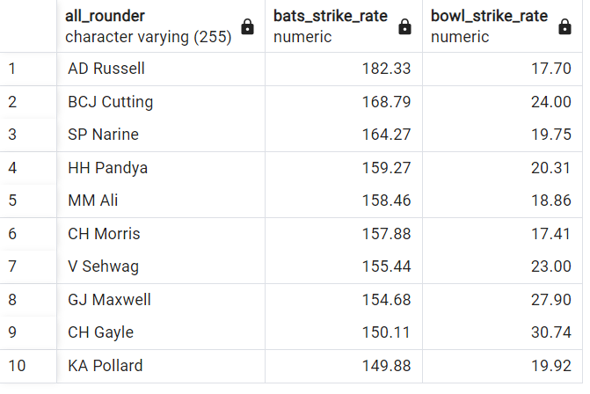

Slide 16
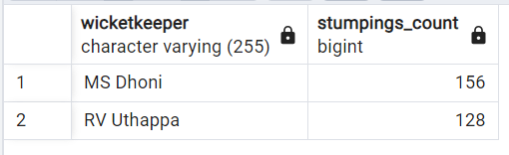
WICKET-KEEPERS
SELECT fielder AS wicketkeeper,
COUNT(*) AS stumpings_count
FROM IPL_Ball
WHERE dismissal_kind = 'stumped' AND fielder IS NOT NULL
GROUP BY fielder
ORDER BY stumpings_count DESC
LIMIT 2;

Slide 17
CRITERIA FOR SELECTING WICKET-KEEPERS
Batting Ability: Prioritize wicketkeepers who can score quickly and hit boundaries, contributing to the team's run total.
Agility and Glovework: Strong wicketkeeping skills are vital. Look for wicketkeepers with quick reflexes, clean catching ability, and accurate stumpings.
Experience: Consider wicketkeepers with T20 experience who can handle pressure situations effectively.
Versatility: Choose wicketkeepers who can adapt to different match scenarios and contribute effectively in various batting positions.
Leadership and Communication: Wicketkeepers who can lead the fielding unit and effectively communicate with bowlers and fielders are valuable.
Fielding: Prioritize wicketkeepers with excellent fielding skills, capable of creating run-out opportunities.
Consistency: Look for wicketkeepers with a consistent track record, both in batting and wicketkeeping, to ensure stable performance throughout the tournament.

Slide 18
ADDITIONAL
QUESTIONS

Slide 19
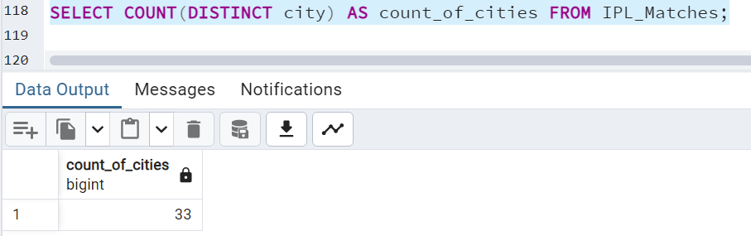
1. Get the count of cities that have hosted an IPL match

Slide 20
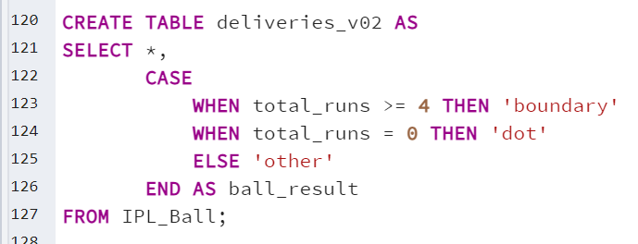
2. Create table deliveries_v02 with all the columns of the table ‘deliveries’ and an additional column ball_result containing values boundary, dot or other depending on the total_run

Slide 21
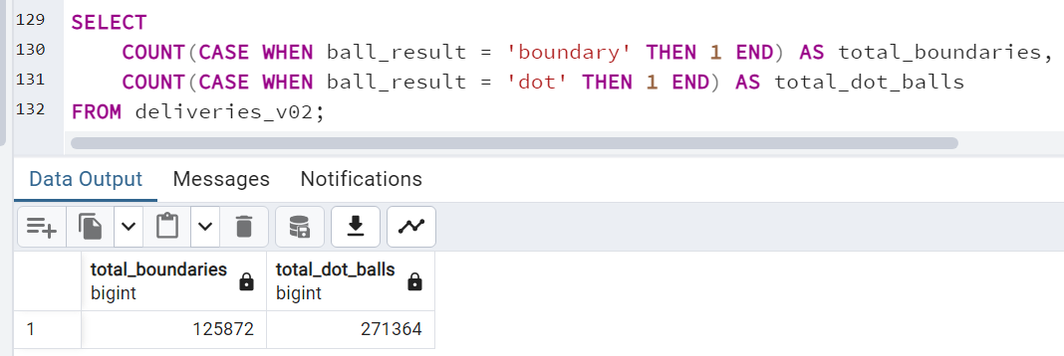
3. Write a query to fetch the total number of boundaries and dot balls from the deliveries_v02 table.

Slide 22
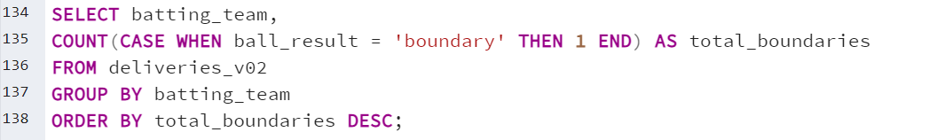
4. Write a query to fetch the total number of boundaries scored by each team from the deliveries_v02 table and order it in descending order of the number of boundaries scored.

Slide 23
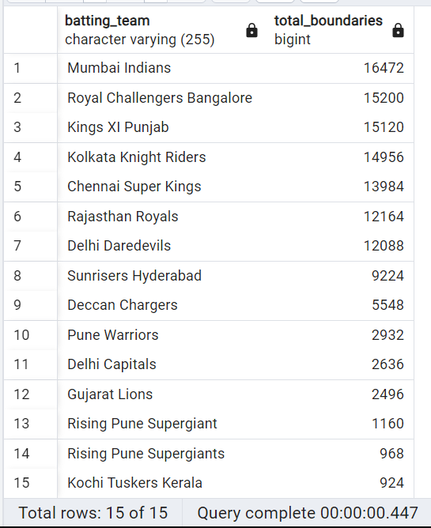

Slide 24
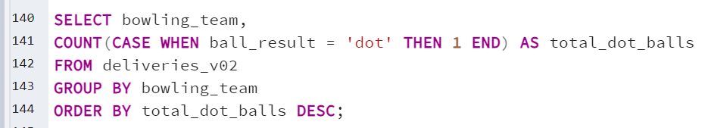
5. Write a query to fetch the total number of dot balls bowled by each team and order it in descending order of the total number of dot balls bowled.

Slide 25
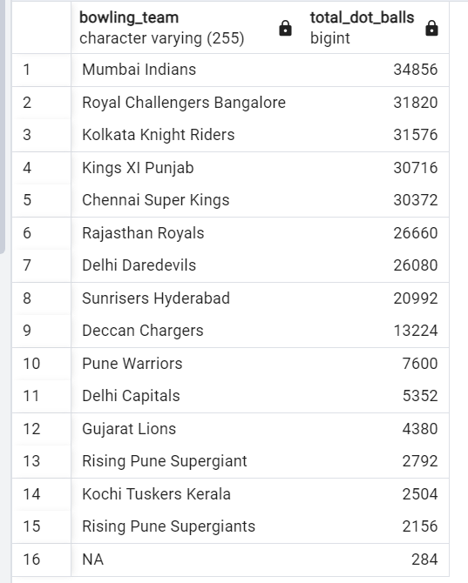

Slide 26
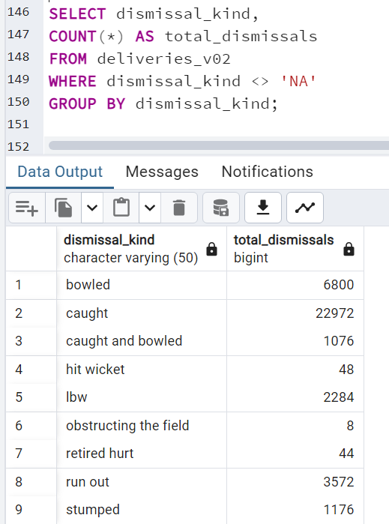
6. Write a query to fetch the total number of dismissals by dismissal kinds where dismissal kind is not NA

Slide 27
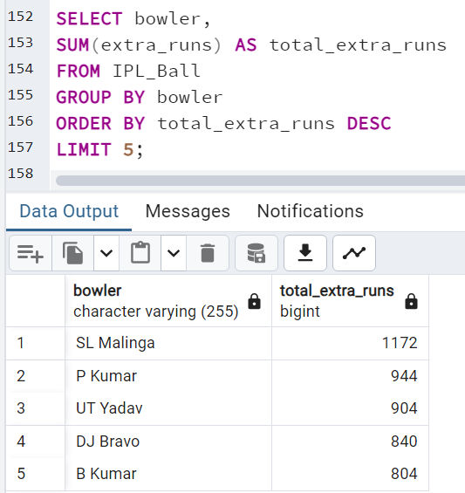
7. Write a query to get the top 5 bowlers who conceded maximum extra runs from the deliveries table

Slide 28
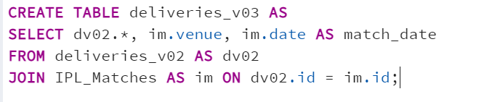
8. Write a query to create a table named deliveries_v03 with all the columns of deliveries_v02 table and two additional column (named venue and match_date) of venue and date from table matches

Slide 29
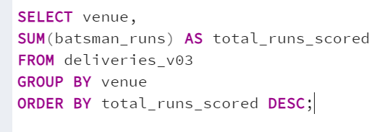
9. Write a query to fetch the total runs scored for each venue and order it in the descending order of total runs scored.

Slide 30
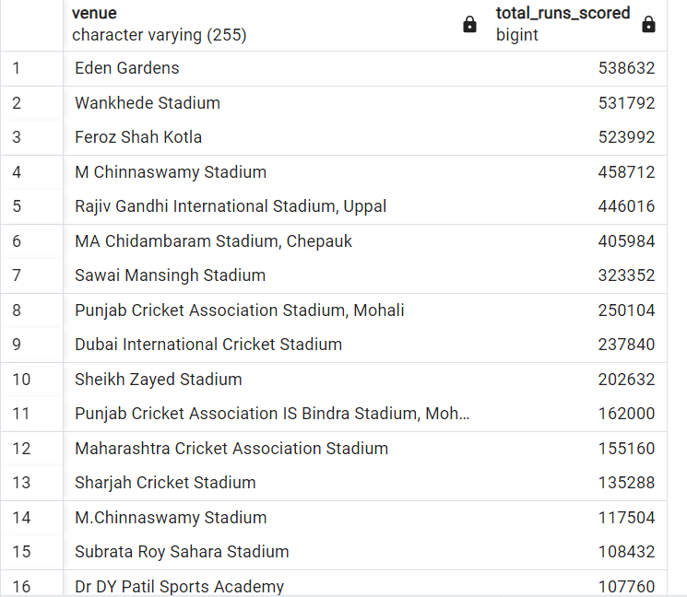
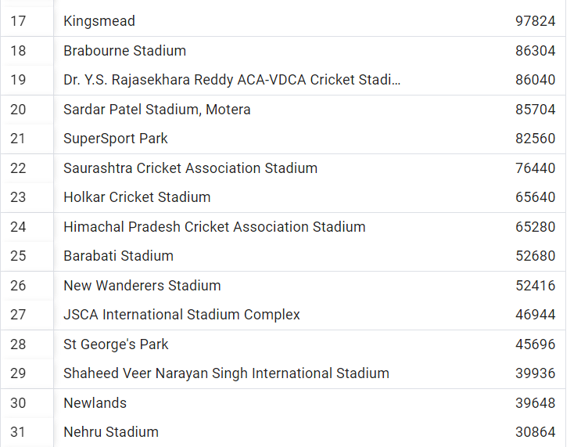
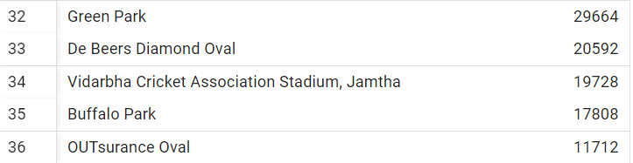

Slide 31
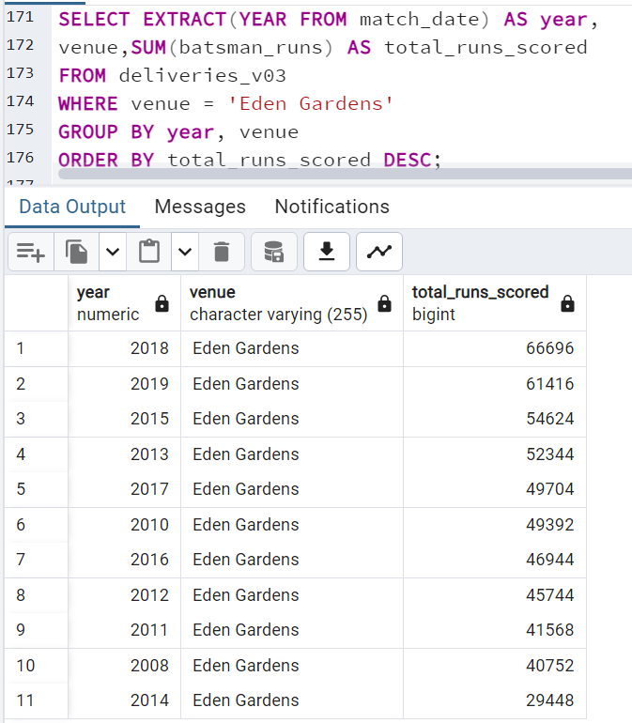
10. Write a query to fetch the year-wise total runs scored at Eden Gardens and order it in the descending order of total runs scored.

Slide 32
THANK YOU

